Slide 1














Cost-Aware Real-Time Multi-VM Workflow Scheduling in Cloud using Genetic Algorithm​
Project Presentation

Slide 2
Team.
1. Anurag Choudhary (20223046)
2. Abhay Kumar (20223004)​
3. Danapana Rahul Reddy (20223078)
4. Akula Sri Subramania Mukesh (20223530)
Under guidance of Dr. Ashish Kumar Maurya

Slide 3

INTRODUCTION.
Cloud computing enablesdistributed task executionacross heterogeneous VMs.​
Efficient scheduling reducescost and make-span whilemaintaining QoS.​
Workflow scheduling is NP-hard problem thus there isneed to find an efficientway to solve this.

Slide 4
Latest schedulers like GA-DQN has parallelism at corelevel but not at VM level
01.
Real-time workloads requirelightweight, adaptivescheduling algorithm.
02.
MOTIVATION.
RT-GA integrates VMstate(waiting time) into GAfor a scheduler that givesresult in real-time along withparallelism at VM level andcore level .​
03.

Slide 5

Related work.
HEFT – Static heuristic,efficient but not adaptive.
2. GA – Strong global search, but high time complexity.
3. GA-DQN – Combines GAand DRL but incurs heavytraining cost.

Slide 6

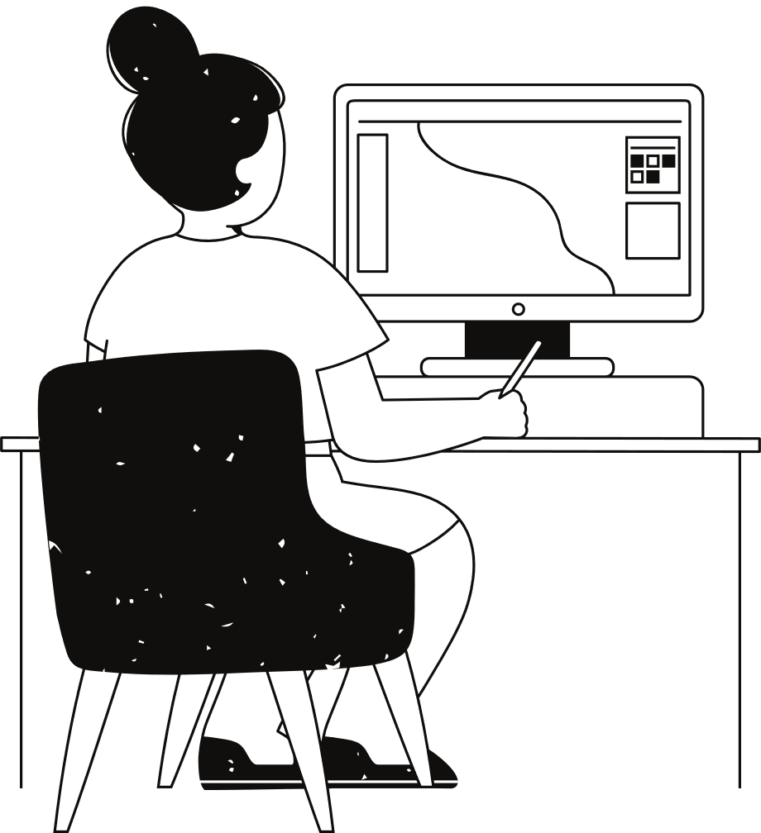
Problem
Statement.
Existing GA-DQN allocates whole workflows to single VMs — limiting parallelism.​
Dynamic VM load and waiting times are ignored by static GA.​
Goal: Design a scheduler that adapts in real-time with multi-VM allocation.

Slide 7
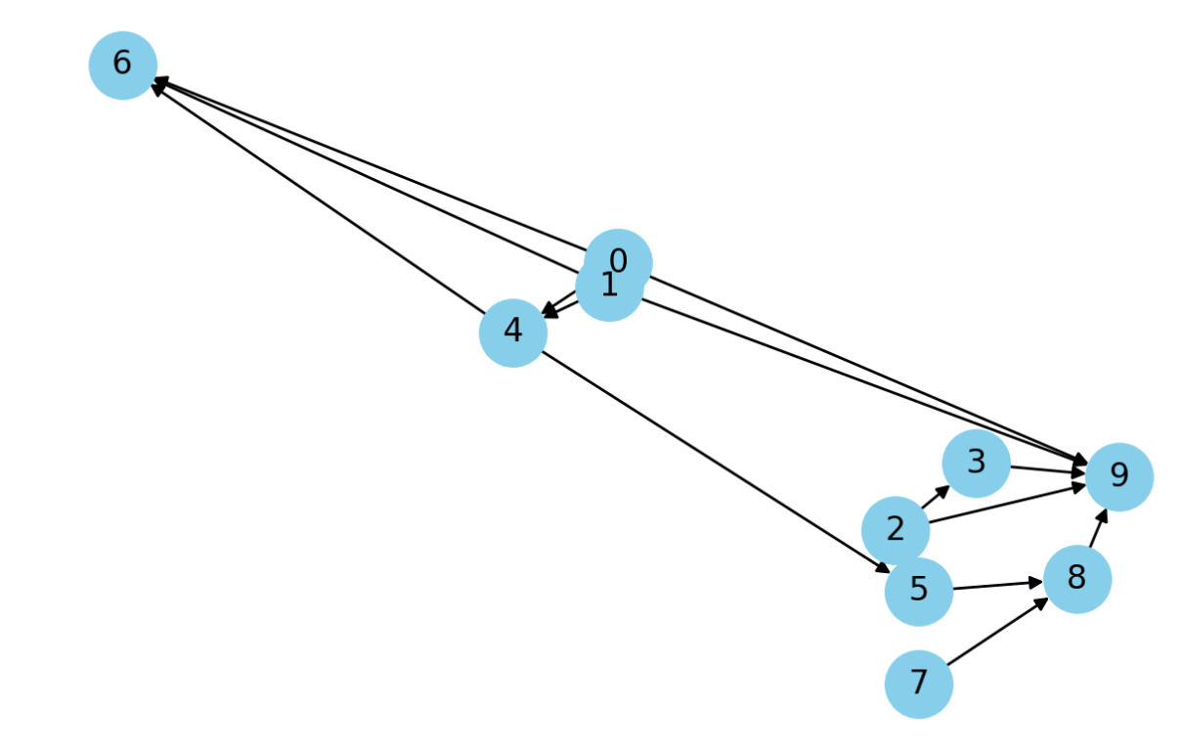

Slide 8
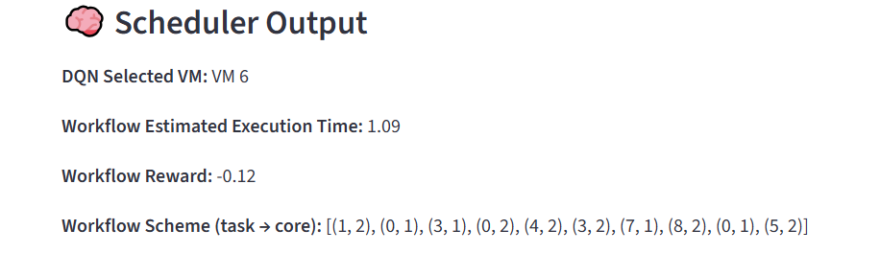

Slide 9
Integrate VM state into GA fitness function.
Enable fine-grained task distribution across multiple VMs.
Reduce execution cost and make-span while maintaining low computation overhead.
Objectives.

Slide 10
System Architecture.
(Three -layer
Design)
Workflow Input Module – parses task DAGs.
RT-GA Scheduler – population evolution and fitness updates.
Cloud Infrastructure – executes tasks Consists of VM each having multiple cores.

Slide 11
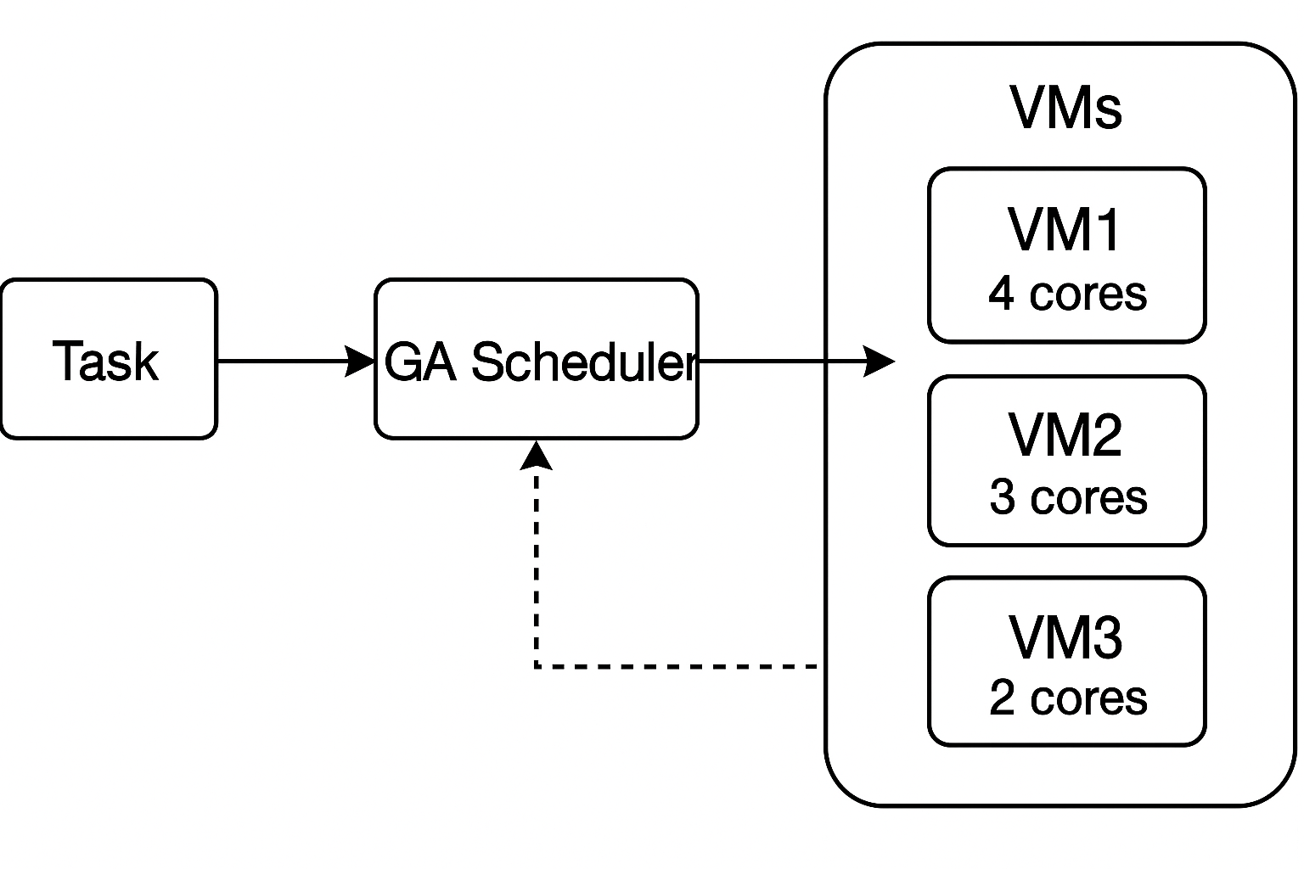

Slide 12
RTGA Framework Modules.
Genetic
Operators
Fitness
Evaluation
Feedback
Loop
Population
Initialization
01
02
03
04
crossover and mutation.
uses make-span , cost, communication cost to calculate fitness.
updates VM states dynamically.
Randomly allocate VM cores to workflow subtask taking care of the dependencies (topo sort).

Slide 13
RT-GA Algorithm​.
1. Gather real-time VM stats.
2. Initialize population by randomly allocating cores.
3. Simulate execution and compute make span and cost.
4. Evolve population via selection, crossover, mutation.
5. Return the best schedule.

Slide 14
Chromosome Encoding &Fitness.
Chromosome encodes task-to-VM-core mapping.
2. Fitness Function: F = α·T_makespan + β·C_total + γ·D_comm.
3. Adaptive mutation based on VM congestion.

Slide 15
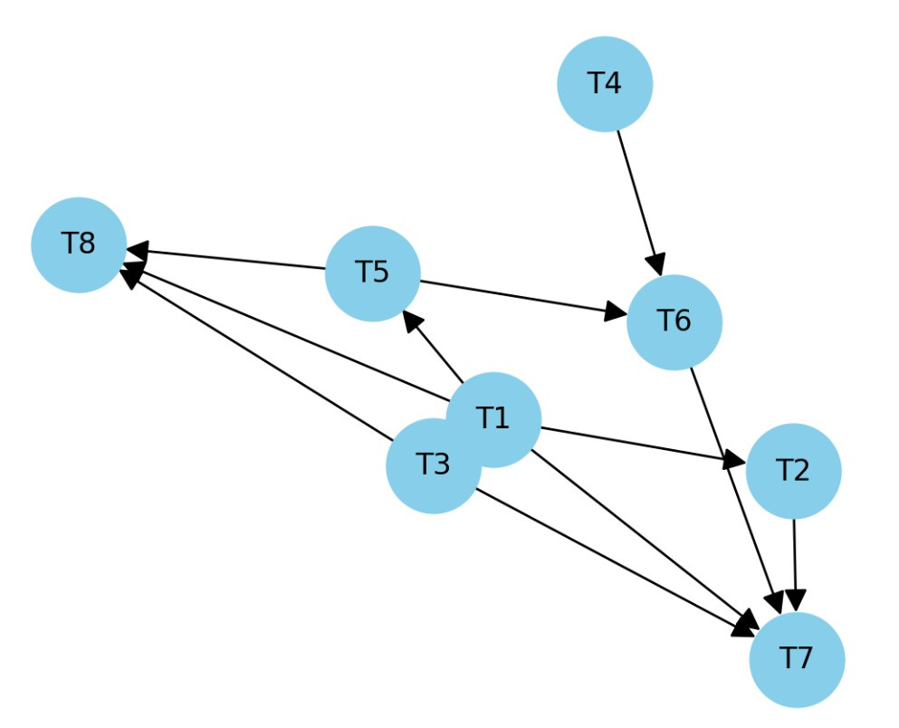
Eg.

Slide 16
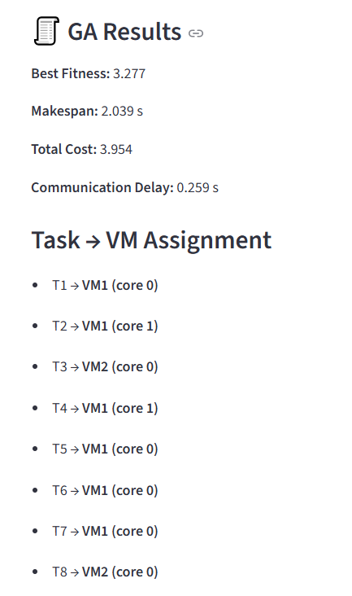

Slide 17
RT-GA Algorithm​
Summary.
1. Input workflow DAG and VM state i.e. waiting time .​
2. Initialize population (random + heuristic).​
3. Evaluate fitness via simulation.​
4. Perform selection, crossover, mutation.​
5. Return the best schedule.

Slide 18


RT-GA efficiently adapts to runtime workload changes.
Eliminates need for DRL training overhead.
Discussion
The scheduler allows inter-VM resource allocation to workflow.
Suitable for dynamic and real-time cloud environments.

Slide 19
Conclusion.
Proposed RT-GA integrates feedback-driven adaptation into GA.
2. Improves makespan, cost, and utilization in multi-VM environments.
3. Future Work: Extend RT-GA to fog/edge environments and hybrid multi-agent learning.

Slide 20
Thank you.

